Slide 1
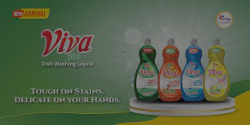


VIVA DISHWASHING LIQUID
DECEMBER CONTENT CALENDAR

Slide 2
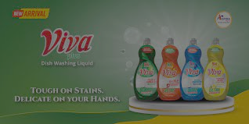
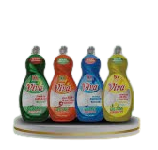
In December, a month synonymous with festivities and Christmas, our campaign aims to embrace the spirit of togetherness, celebration, and joy. We plan to engage our Consumers by exploring various facets of our brand’
Our strategy involves creating interactive and compelling activities throughout the month, encouraging consumers to actively participate, share experiences, and discuss relevant topics that matter to them.
DIRECTION >>>

Slide 3
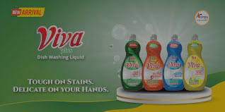
WEEK 1

Slide 4
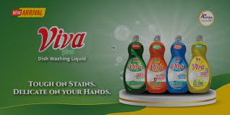
Date: Friday 1st of December
IDEA: HAPPY NEW MONTH
COPY: Cheers to a Squeaky-clean December
CAPTION: Make your Detty December Squeaky- Clean with VIVA DISHWASHING LIQUID
#SqueakycleanwithVIVA #EnjoyableChoreMoments #funwithchoresthischristmas #5XpowerwithVIVA #IlovemyVIVA #ChristmaswithVIVA

Slide 5
WEEK 2

Slide 6
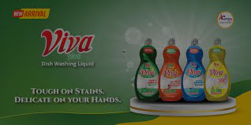
Date: Wednesday 5th of December
IDEA: Discussing VIVA
COPY: Five Fun Fact about VIVA
CAPTION: Five Fun Facts You didn't know about your Favorite brand VIVA
#funwithchoresthischristmas #5XpowerwithVIVA #IlovemyVIVA #ChristmaswithVIVA

Slide 7
WEEK 3

Slide 8
Date: Sunday 10th of December
IDEA: Discussing the Brand
COPY: Rep your Favorite Variant
CAPTION: Hello Vivans, Share you preferred dishwashing liquid variant with us and why in the comment section!
#TeamZestylemon
#TeamOriginal
#TeamSeabreeze
#TeamAnti-bacterial
#FunWithChoresThisChristmas #5XpowerwithVIVA

Slide 9
Date: Friday 15th of December
IDEA: Celebrating Mothers
COPY: Super Moms Loves VIVA
CAPTION: This Christmas, we raise a toast to the unsung heroes in our lives- mothers, Your Love, warmth, and magic make the season truly special
#ChristmasCheers
#MomMagicWithViva
#FunWithChoresThisChristmas #5XpowerwithVIVA

Slide 10
WEEK 4

Slide 11
Date: Wednesday 20th of December
IDEA: Counting Down To Christmas
COPY: Countdown To Christmas With VIVA
CAPTION: Unwrap the magic of Christmas with these fun festive facts! Did you know about the origin of candy canes, the global names for Santa Claus, or the record-breaking gift wrapping event? Share with us in the comment section fun facts about Christmas and dive into the enchanting world of Christmas traditions!
#ChristmasFacts #FestiveTrivia #SqueakycleanChristmasWithVIVA
#FunWithChoresThisChristmas #5XpowerwithVIVA

Slide 12
Date: Monday 25th of December
IDEA: Christmas Day
COPY: Joy to the World, Joy in the Wash
CAPTION: Let the holiday sparkle linger beyond the feast! Embrace a kitchen filled with laughter and clean dishes, making Christmas Day merrier with Viva dishwashing liquid magic touch. Cheers to a festive season of joy, love, and gleaming kitchens!
#ChristmasMagic #CleanAndBrightWithVIVA
#SqueakycleanChristmasWithVIVA
#FunWithChoresThisChristmas #5XpowerwithVIVA

